Slide 1
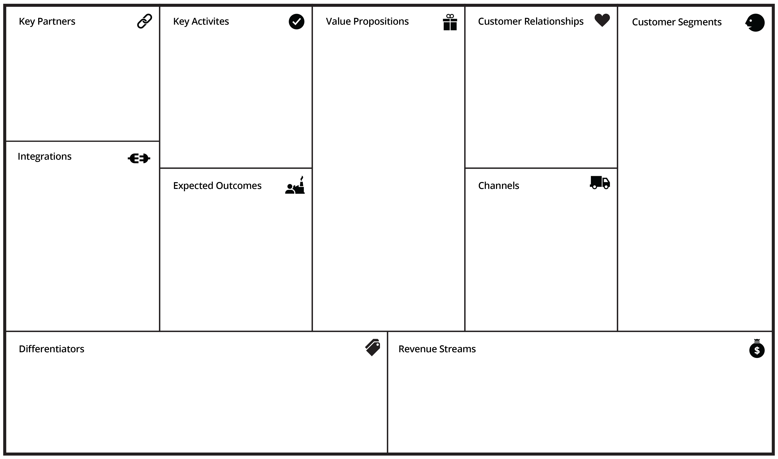
BUSINESS
MODEL
CANVAS
Calls
Forms
Chat Interactions
Content Worth Marketing
They say
And this
And that
Segment 1
Segment 2
Segment …
To get where you're going you need to row in the same direction.
In order to strategize effective marketing initiatives, you need to have clarity on your specific business drivers. This strategic management template helps everyone on the team quickly align around your business approach.
#1
#2
Speed to Solution
Generate Leads
Scale System
Brand Visibility
AdWords
Bing
Social Media
YouTube

Slide 2
BUSINESS MODEL CANVAS: THOUGHT PROCESS
CUSTOMER SEGMENTS
Who are they?
What do they think?
What do they do?
VALUE PROPOSITION
What’s compelling?
What’s your unfair competitive advantage?
Why do they buy from you?
CHANNELS
How are you positioned to sell your product? Deliver?
CUSTOMER RELATIONS
How do you interact throughout the customer journey?
INTEGRATIONS
What tools do you need in order to reach your goals?
REVENUE STREAM
How do generate revenue from your value proposition?
EXPECTED OUTCOMES
What does your customer expect will happen as a result of buying your product?
KEY ACTIVITIES
What things do you need to deliver?
KEY PARTNERSHIPS
What can you not do (who do you need) so you can focus on delivery?
DIFFERENTIATORS
What do you do better than anyone in your space? What combination of features makes you special?

